Slide 1
XPC Chart Review Simulator: Meet Bill Moore.
Morris Aguilar, Ph.D.
Generative AI (GenAI) Fellow at XPC
04-14-2025

Slide 2
Completed Objectives Since Last Meeting: What Moore Do You Want?
Bill Moore’s Chart
Identifying patterns in the sample Bill Moore CR.
Refactored system prompt and JSON schema to emulate the sample chart review doc.
Tested new models to address limitations
Full automation from chart data to camera-ready PDF.
Skill Assessment Dashboard Functional Prototype
Partial completion of the drug price list.

Slide 3
Identifying Patterns in the Chart Review Sample Bill Moore to Optimize LLM Output.
One chart review for two encounters
Two encounters are used as input; otherwise, the genAI outputs are incomplete. Larger search space.
Need to repeat the improvement consideration workflow for all key items for consistency and organization.
For each medical problem, cost-effectiveness, medication alternatives, documentation considerations are needed.
Analogous to a ‘for-loop’.

Slide 4
Insight: As the number of medical problems increases, non-reasoning models struggle.
In other words, single-agent non-reasoning models struggle with tasks analogous to ‘for-loops’ as task complexity increases.
Despite:
Maximizing total token limits beyond necessary.
Same engineered prompt, deterministic structured output, and JSON schema.
Demonstrated templates in the system prompt.
Caveat:
It can be treated as a multi-agent task, but it is out of the scope of this discussion.
Notes:
Gemini pro 2.5 80-100 seconds

Slide 5
Consider the importance of speed and cost as the number of EMRs for Processing Rise.
Source | Context Window (tokens) | Max Output Tokens | Cost per Million Input Tokens | Cost per Million Output Tokens | Chart Review Generation Time
o4-mini | 200K | 100K | $1.10 | $4.40 | 30 - 50 s
Gemini 2.5 Pro | 1M | 64K | $1.25 | $10.00 | 80 – 100 s
Note: Although o4-mini scores higher than Gemini 2.5 Pro on multiple benchmarks, the slight difference is of unknown significance to this application.

Slide 6
Choose One API/Ecosystem and Know it Well. Minimize Chasing SOTA for Small Differences.
Source | Context Window (tokens) | Max Output Tokens | Cost per Million Input Tokens | Cost per Million Output Tokens | Chart Review Generation Time
o4-mini | 200K | 100K | $1.10 | $4.40 | 30 - 50 s
Gemini 2.5 Pro | 1M | 64K | $1.25 | $10.00 | 80 – 100 s
Note: Although o4-mini scores higher than Gemini 2.5 Pro on multiple benchmarks, the slight difference is of unknown significance to this application.

Slide 7








Just Hit `Enter`: Camera Ready PDF + Browser Chart Review Contents.
OpenAI
o4-mini
API
JSON
Format
Output
Browser Ready
Chart Review
Document
Local
Python Code API
Chart
Review
Query
Local
Python Code
Gemini
2.5 Pro
API
JSON
Format
Output
Print Ready
Chart Review
Document

Slide 8
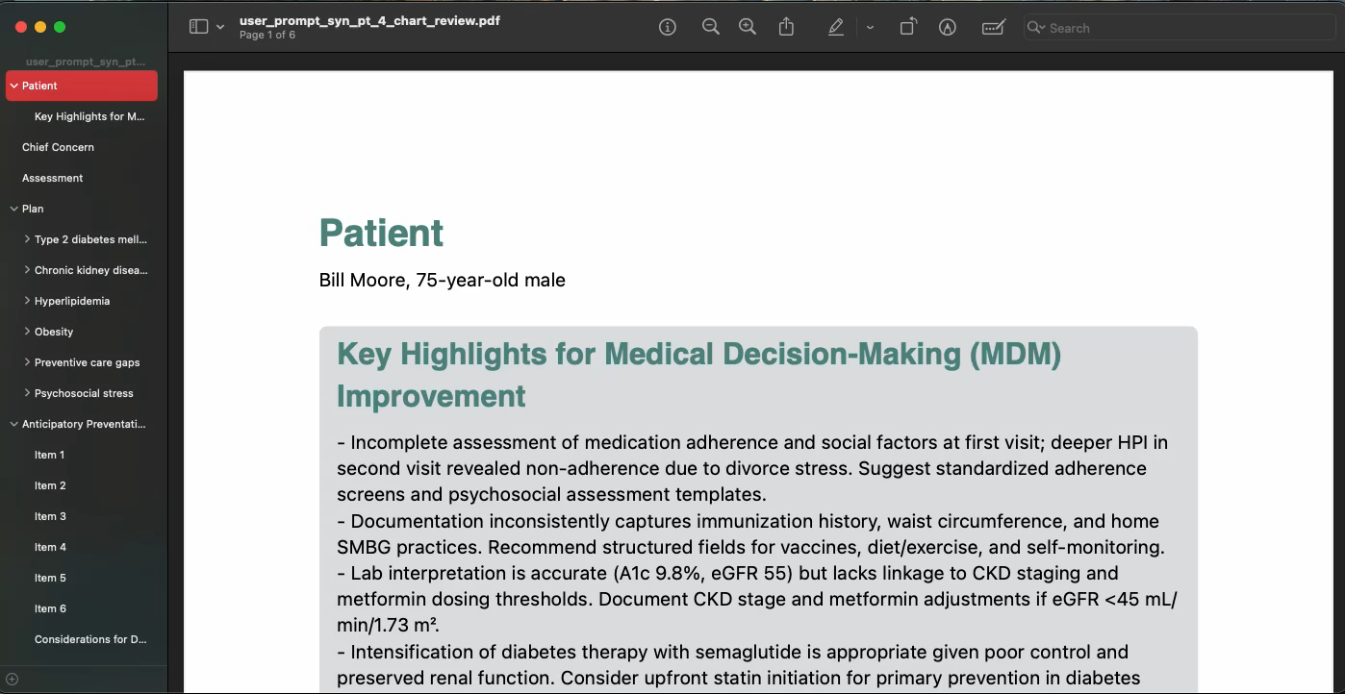
Keep in Mind, None of the Content was Copy/Pasted, or Formatted by Hand.

Slide 9
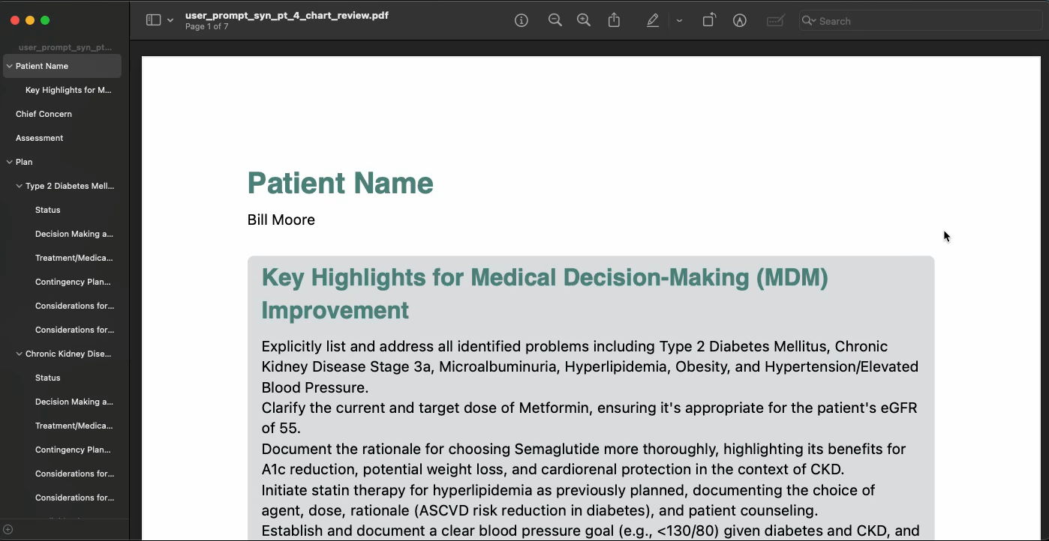
An Example of Having to Manaage Edge cases for GenAI Outputs for Two Platforms

Slide 10
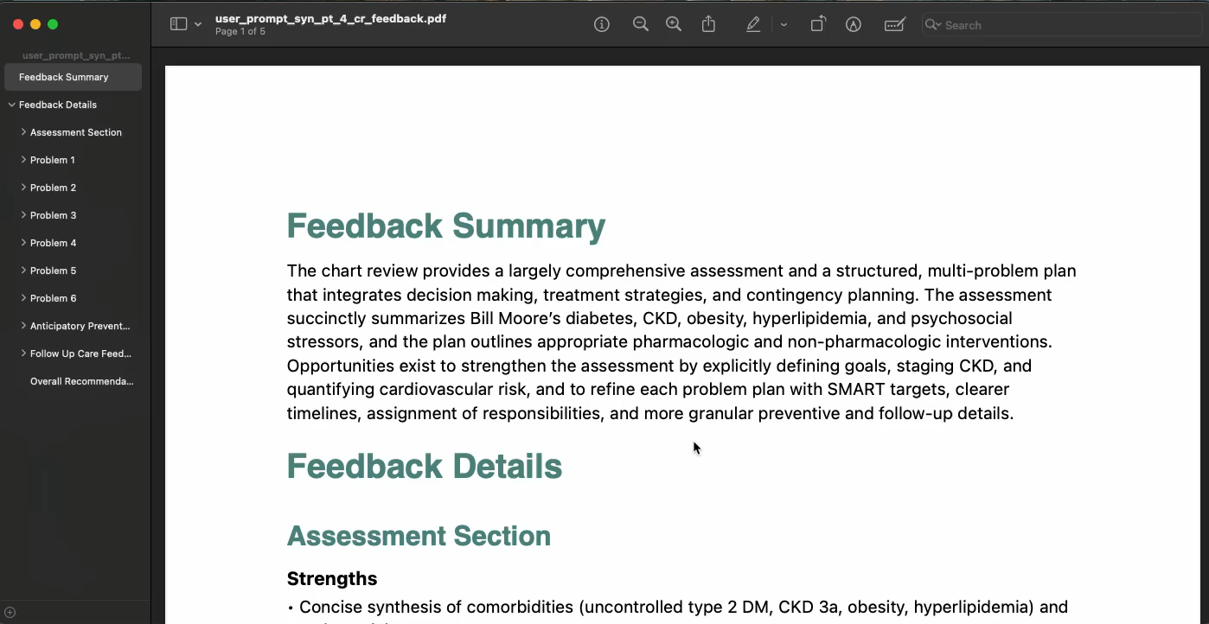
Chart Review Dashboard Functional Prototype

Slide 11
Progress on Calculating Cost-Effective Care
First iteration of programming:
an index all drugs with the UMLS(from NIH) terminology
Indexing the drugs noted in the chart and chart review
Next: computation of costs and appending to PDF report.

Slide 12
Drug Compilation: Sufficient for prototyping, will collect remaining pricing.
Source | Number of Drugs | Dosage Data Completion | 30 Day Supply Price Completion | 90 Day Supply Price Completion | Note
Walmart | 92 | ✓ | ✓ | ✓ | -
Cost Plus Drugs | 1111 | ✓ | ✓ | - | 90 Day Supply to be web-scraped.
Kroger Health Savings | - | - | - | - | Service discontinued.

Slide 13
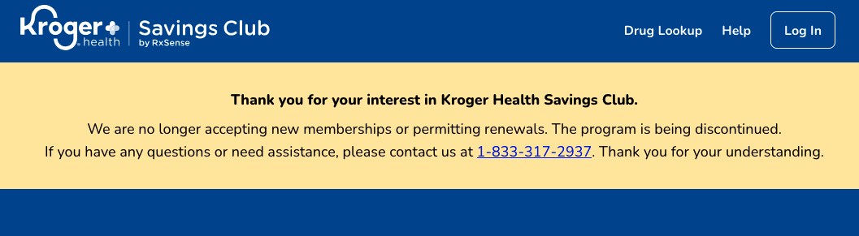
Generic Drugs: Kroger Health Savings Club Discontinued.

Slide 14
Practical Next Steps:
Fine adjustments to the PDF formatting.
e.g. , preventative and follow-up care sections.
Bulk Dashboard: Aggregate trends across other patients.
Integrating the cost-effective medication management analysis.
Notes:
User might want pdf
One to one comparion of bill moore

